Slide 1
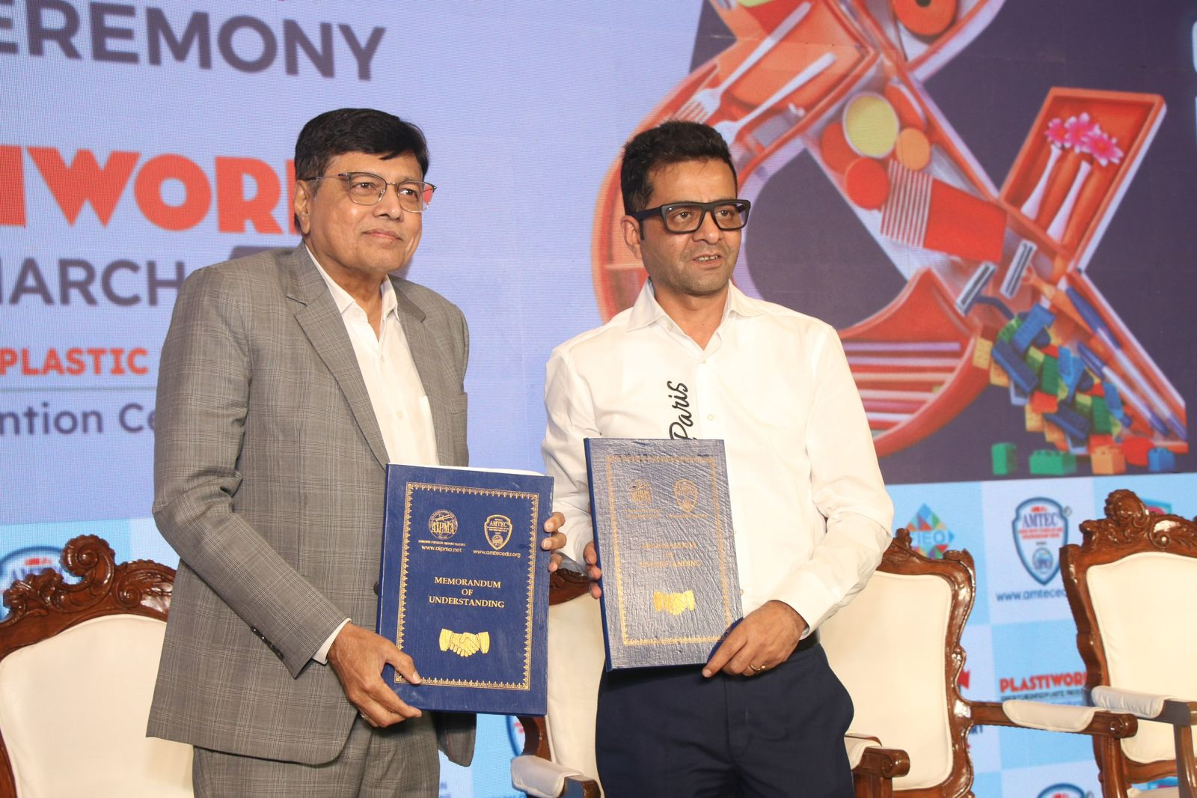

AIPMA × BAA
MoU Highlights
Strengthening Industry–Trade Collaboration
SIGNED · MARCH 2026 · PLASTIWORLD
MoU Signing Ceremony — AIPMA & BAA Representatives
at Plastiworld, March 2026

Slide 2
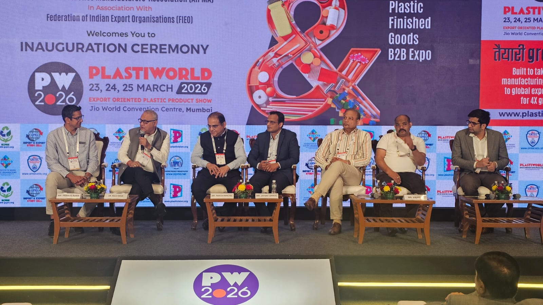
BAA Signs MoU with AIPMA
BAA and AIPMA have joined hands to strengthen industry–trade ties and expand global market access for India’s plastics sector.
🌐 Global Market Access
Connecting AIPMA manufacturers with BAA’s global network of buyers and agents to unlock new export opportunities.
🤝 Joint B2B Events
Co-hosted events at Plastiworld and top trade fairs showcase Indian plastics to a global buyer audience.
Plastiworld 2026 — Industry Panel, Jio World Convention Centre, Mumbai
AIPMA × BAA | Industry–Trade Collaboration

Slide 3


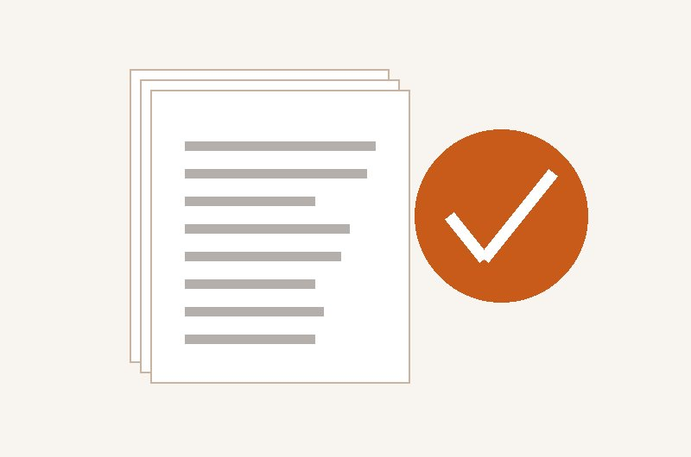

Key Areas of Collaboration
1
Global Buyer Connections
2
B2B Networking Events
Link AIPMA manufacturers with BAA's worldwide network of buying agents and international buyers for new export opportunities.
Co-organise industry events and networking meets at Plastiworld and top trade fairs to showcase Indian plastics to global buyers.
3
Compliance & Export Workshops
4
Policy Advocacy
BAA experts deliver export readiness workshops covering international standards, buyer requirements, and global market trends.
Jointly represent India's plastics and sourcing sectors before government bodies to promote trade facilitation and export-friendly regulations.
AIPMA × BAA | Industry–Trade Collaboration

Slide 4
"We look forward to a productive and
impactful association with AIPMA."
— Buying Agents Association (BAA)
This partnership reflects BAA's commitment to strengthening India's global trade ecosystem through meaningful collaboration with premier industry associations.

